Slide 1
Quick Mart​ E‑Commerce Mobile Application
Quick Mart
Final Project – Android (Kotlin + Jetpack Compose)

Slide 2
1. Project Idea & Objectives
• Build a modern e‑commerce mobile application using Kotlin & Jetpack Compose.​
• Provide a smooth and fast shopping experience with a clean UI.​
• Implement local + remote databases to ensure both offline and online support.​
• Enable users to browse categories, view products, add to cart, and checkout easily.​

Slide 3
2-Team Members
1 2 3 4 5 6
Abdelrahman Elsayed
Mohamed Ahmed Elsayed
Yamine Mohamed Hassan
Nour Ahmed Gamal
Hana Abdelkader Attia
Jana Haitham Mohamed

Slide 4
3-Project Explanation
The app is built using MVVM architecture, separating UI, business logic, and data handling.
Home Screen: Displays featured products, offers, and categories
Categories Screen: Allows users to browse products by category, with offline fallback if the internet is not available.
Product Cards: Show images, title, price, and discount, with options to add to cart.
Cart & Checkout: Users can view selected products, adjust quantities, and proceed to checkout.
Offline & Caching: Products and categories are stored locally, providing seamless experience during network issues.
Technology Stack: Kotlin, Jetpack Compose, Retrofit, Coil, Room, Coroutines, StateFlow.

Slide 5
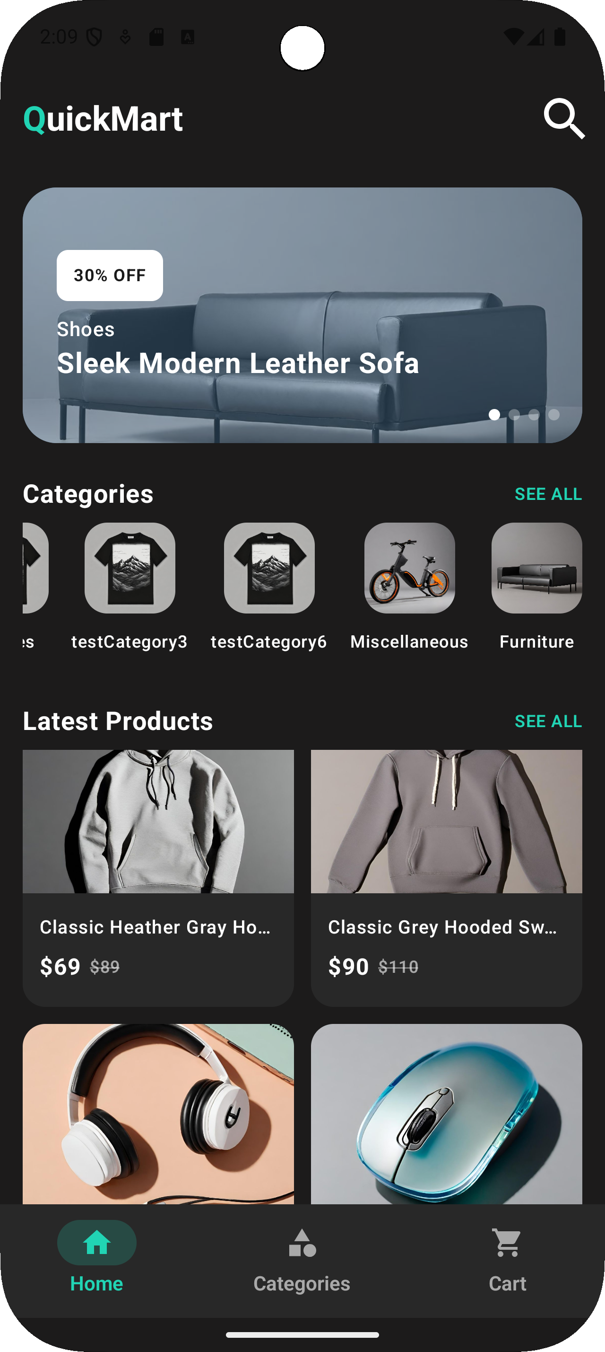
01
• Home Screen
1. Offers Slider (Auto Image Carousel)
We implemented an offers slider that automatically displays promotional banners one after another.
2. Categories Section
display all available categories. This helps users quickly explore the type of products they want.
Categories come from Remote API with Local Room fallback.
If the internet is not available, categories still load from the local database.
3. Featured Products Preview
show a preview of recommended or featured products from different categories. This allows the user to browse products quickly without needing to open each category.
4-Key Features

Slide 6
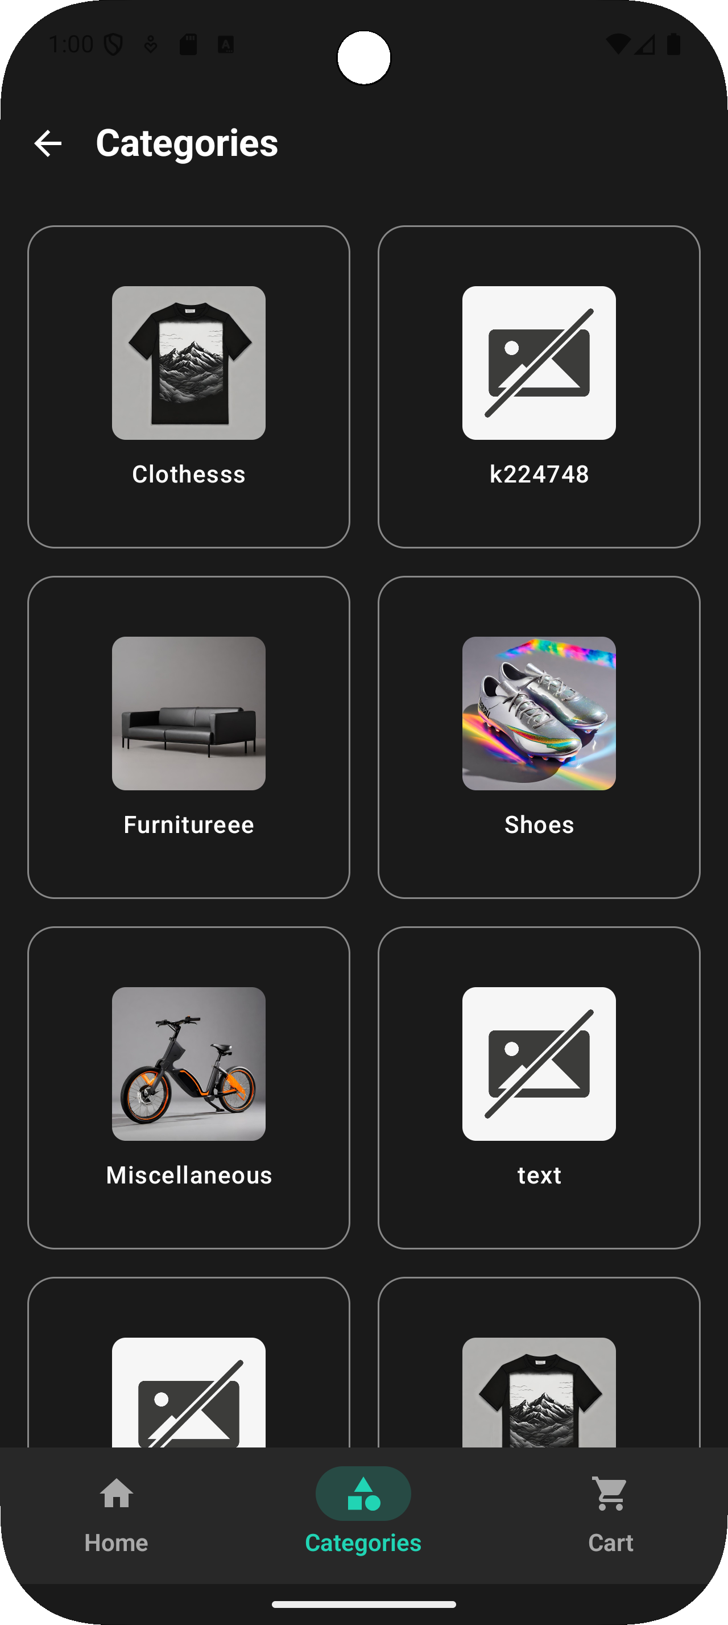
02 • Categories Screen
.The Categories feature retrieves the full list of product categories from the remote API. If the network is unavailable, the application automatically falls back to the local Room database, ensuring smooth offline support. Categories are displayed in a clean grid UI using Jetpack Compose. Each category shows an image and a name, and once a category is selected, its name is saved in the ViewModel to trigger loading relevant products.

Slide 7
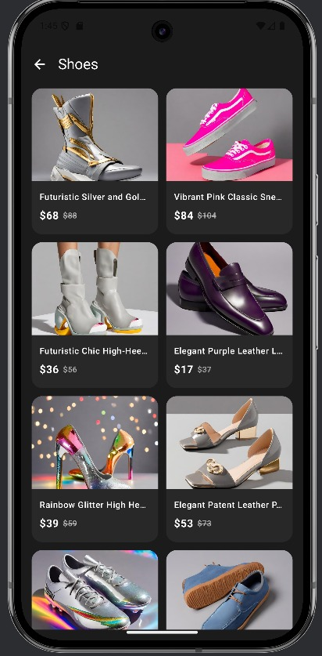
03 • Products Screen
. After selecting a category, the system loads all products from the remote API and filters them based on the chosen category name.
The ViewModel manages loading states and data flow, ensuring the UI updates immediately. Products are displayed in a separate screen, and each item supports a "favorite" toggle for wishlist functionality.

Slide 8
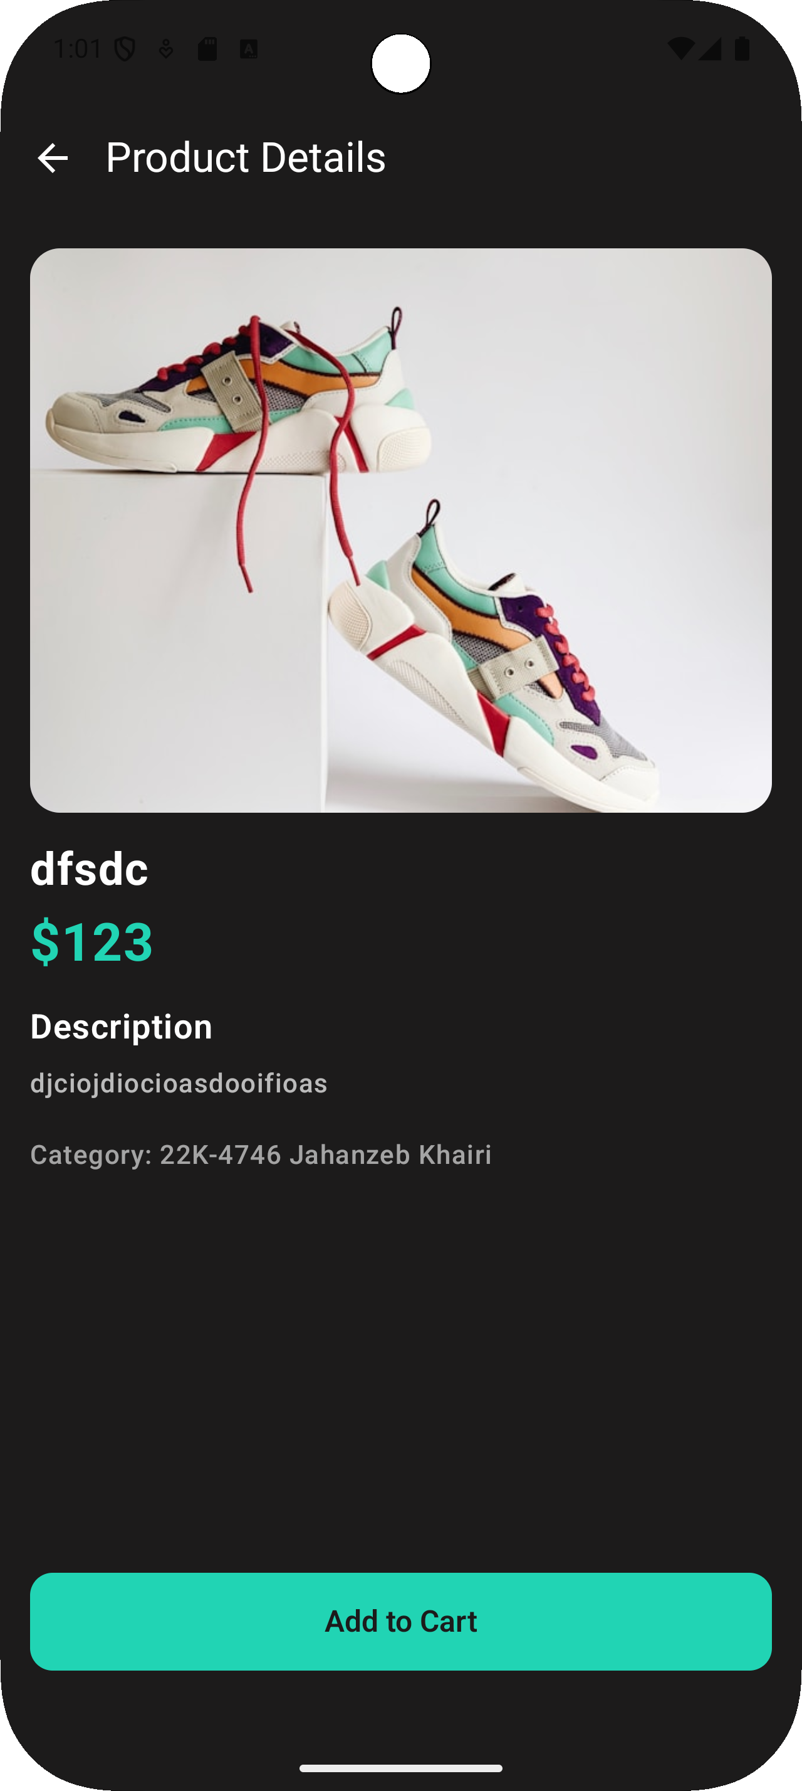
04 • Details Screen
🔹 Product Information: Shows title, price, description, ratings, and reviews, giving the user all necessary details.
🔹 Quantity Selector: Allows users to choose the number of items they want to purchase before adding to cart.
🔹 Add to Cart & Wishlist: Quick buttons for adding to cart or saving to wishlist for later purchase.

Slide 9
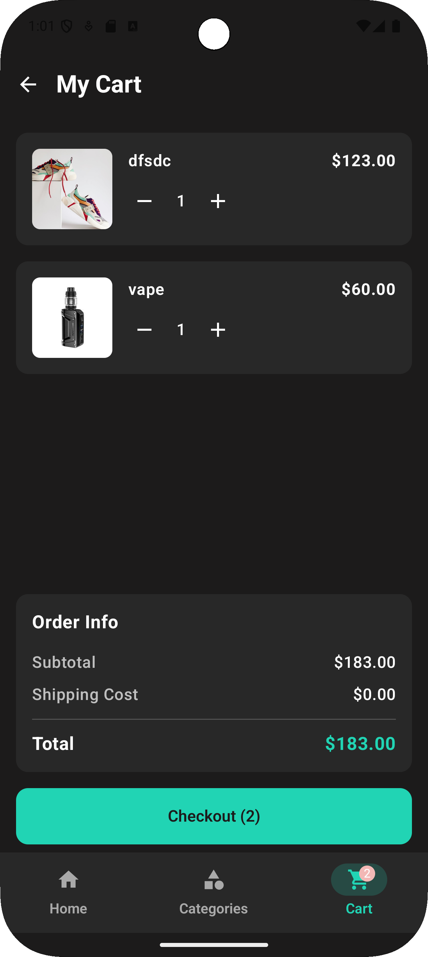
05 • Checkout
1. Cart Screen
· Full cart management UI with product listing
· Interactive quantity controls (+/- buttons)
· Real-time order summary & total calculation
· Direct Room Database integration
2. Payment Screen
· Secure payment form with all required fields
· Smart validation (card, expiry, CVV, phone)
· Clean UX with error feedback
· Large "Confirm" button for easy tapping
3. Checkout Flow
· Complete MVVM architecture with StateFlow
· Local data persistence using Room
· Smooth navigation between screens
· Success confirmation with "Continue Shopping”

Slide 10
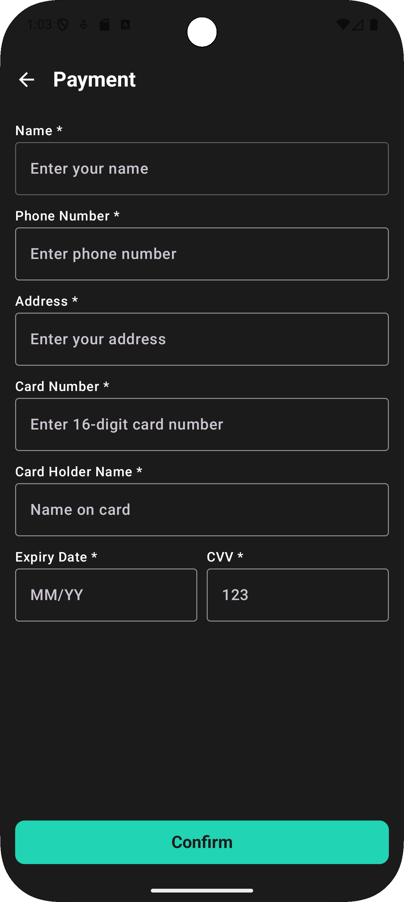
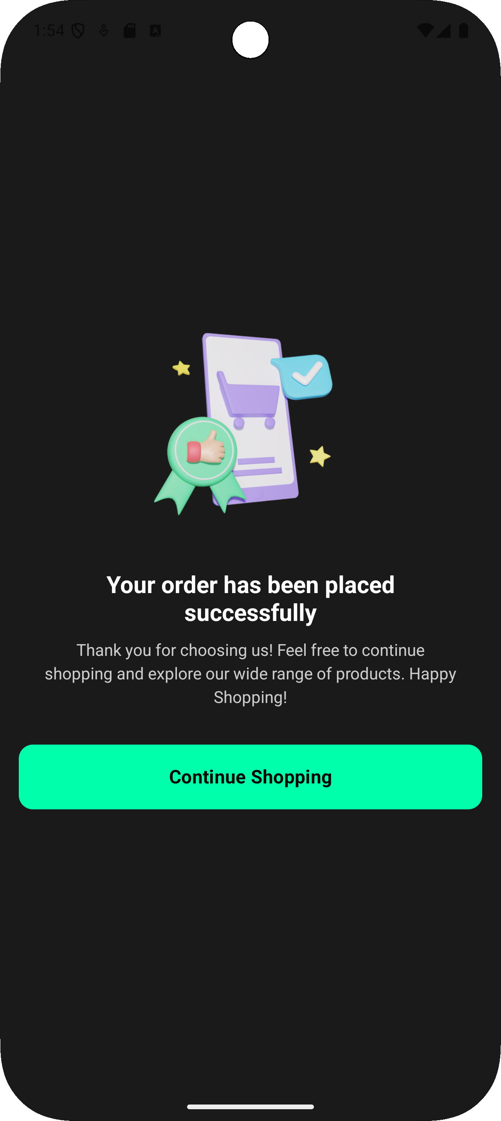
Cart Screen UI
· Organized product cards with images & prices
· Quantity adjusters for each item
· Order breakdown (Subtotal + Total)
· Dynamic checkout button showing item count
Payment Screen UI
· Clear form layout with required field indicators
· Smart input fields (16-digit card, MM/YY expiry, 3-digit CVV)
· Helpful placeholder hints
· Prominent confirmation button

Slide 11
5-Future Marketing Strategies
1. Launch on Official App Stores
· Publish on Google Play Store with a detailed description, screenshots, and promotional video.
· Highlight unique features: offline mode, floating cart button, and organized browsing.
2. Social Media Campaigns
· Run ads on Instagram, Facebook, and TikTok showcasing the app’s smooth UI and key features.
· Collaborate with influencers in the shopping and tech niches for reviews and tutorials.
3. Referral & Loyalty Programs
· Implement a referral system where users earn discounts for inviting friends.
· Introduce a loyalty program with points for purchases, reviews, and wishlist saves.
4. Partnerships & Promotions
· Partner with local or online brands for exclusive offers within the app.
· Offer limited-time promotions for new users (e.g., first purchase discount).

Slide 12
6-Future Development & Feature Enhancements
1. Real Payment Integration
· Integrate secure payment gateways like Visa, MasterCard, PayPal, and mobile wallets.
2. Personalized Recommendations
· Implement AI-based product recommendations based on browsing and purchase history.
3. User Accounts & Cloud Sync
· Allow users to create accounts and sync cart, wishlist, and order history across devices.
4. Push Notifications
· Send order updates, promotional offers, and restock alerts to keep users engaged.
5. Multi-language & Currency Support
· Expand market reach by adding multiple languages and local currency options.
6. Advanced Search Filters
· Include filters by price range, brand, ratings, and delivery options.

Slide 13
7. Augmented Reality (AR) Preview
· Allow users to visualize products (e.g., furniture, clothing) in their real environment.
8. Voice Search
· Implement voice-activated search for hands-free shopping.
9. Customer Support Chatbot
· Integrate an AI chatbot for instant support and FAQs.
10. Sustainability & Social Impact Features
· Add a “green products” section or donation options at checkout to attract eco-conscious users.
“This plan will help position Quick Mart as a modern, user-friendly, and competitive e-commerce app in the growing mobile shopping market.”

